Slide 1
Sentimental analysis
Submitted By :- Prabal Katiyar (1802913106)
5th Sem It-b
Submitted To :- prof. Navpreet Kaur

Slide 2
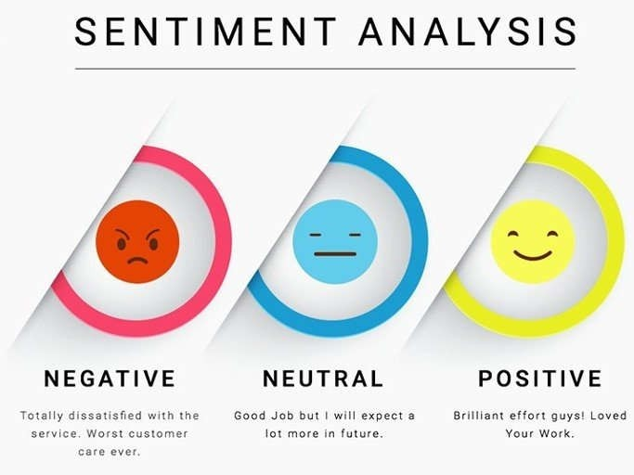
Sentiment analysis
Sentiment Analysis aims to determine the attitude of a speaker, writer, or other subject with respect to some topic or the overall contextual polarity or emotional reaction to a document, interaction, or event.
The applications of sentiment analysis are broad and powerful. The ability to extract insights from social data is a practice that is being widely adopted by organizations across the world

Slide 3
Twitter Sentiment analysis
Twitter is an online news and social networking service that enables users to send and read short 140-character messages called "tweets". Registered users can read and post tweets, but those who are unregistered can only read them.
Sentiment Analysis is a tools to analyze opinions in Twitter data can help companies understand how people are talking about their brand. ... This is one of the reasons why social listening ― monitoring conversations on social media platforms ― has become a crucial process in social media marketing.

Slide 4
Project overview
Tweets are imported using R and the data is cleaned by removing emoticons and URLs. Lexical Analysis is used to predict the sentiment of tweets and subsequently express the opinion graphically through ggplots.
Steps
Extraction of Tweets
Loading Tweets
Cleaning Tweets
Use the get_nrc_sentiment function to analyze sentiments.
Use the Barplot to visualize the sentiments

Slide 5
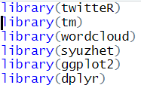
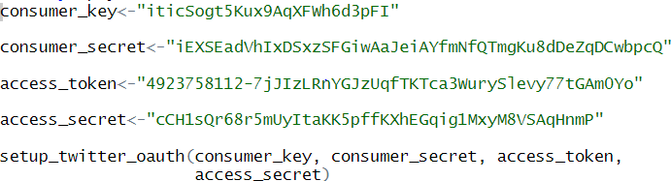
Implementation (using get_nrc_sentiment function)
Loading Libraries
Setup twitter oauth using access token

Slide 6
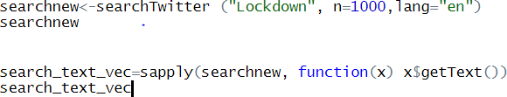
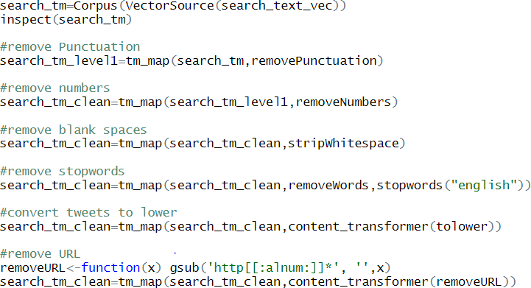
Implementation (using get_nrc_sentiment function)
Loading Tweets on “Lockdown” contains 1000 tweets
Data cleaning

Slide 7

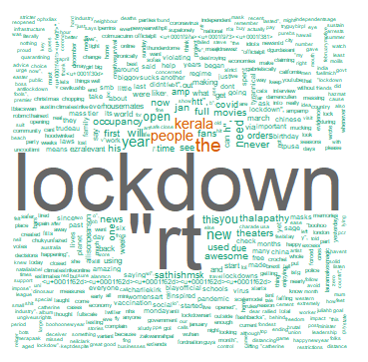
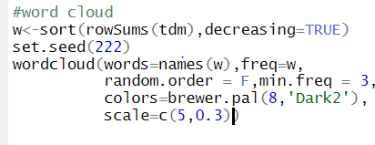
Implementation (using get_nrc_sentiment function)
Converting in Textdocument Matrix
Creating Wordcloud
Output of Wordcloud :-

Slide 8


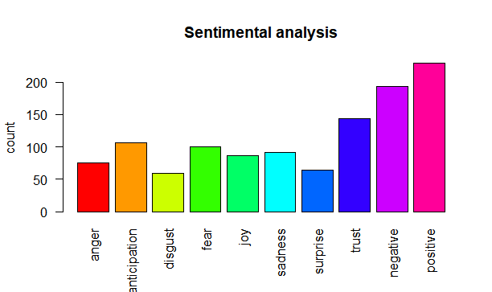
Implementation (using get_nrc_sentiment function)
Obtain sentiment using “get_nrc_sentiment” function built in syuzhet package in R.
Barplot to visualize the sentiments:
Conclusion using get_nrc_sentiment
function :-

Slide 9


